Slide 1





From environment-driven to branch-driven ALM
Power Platform and GitHub CI/CD blueprintTranslate environment-first flows into branch-defined artifacts, pipelines, and an emergency hotfix lane for repeatable releases.
Skandan
AI/ML Engineer

Slide 2








Environment-Driven Flow: Dev as Source of Truth
Current pipeline sequence and artifact ownership
Dev env is the central source of truth
Replace pipeline creates temp solution in Dev
Developers make changes directly in Dev env
Unpack pipeline exports from Dev, unpacks, commits to local branch then merged to master
Environment drives what is exported and promoted
Temporary solution generated in Dev environment
Work happens inside the Dev environment
Diagram notes: Dev env at center with arrows to Unpack, Pack, CD
Export, unpack, commit to developer local branch, then merge
Annotate: Env = source of truth
Pack pipeline exports from Dev and publishes to Dev env
CD pipeline takes exported artifact from Dev env and promotes to SIT then UAT then PreProd then Prod
Git used primarily for history, not authoritative artifact
Export again and publish back to Dev environment
Git records history; Dev environment is authoritative
Promotion sequence: SIT, UAT, PreProd, Prod

Slide 3
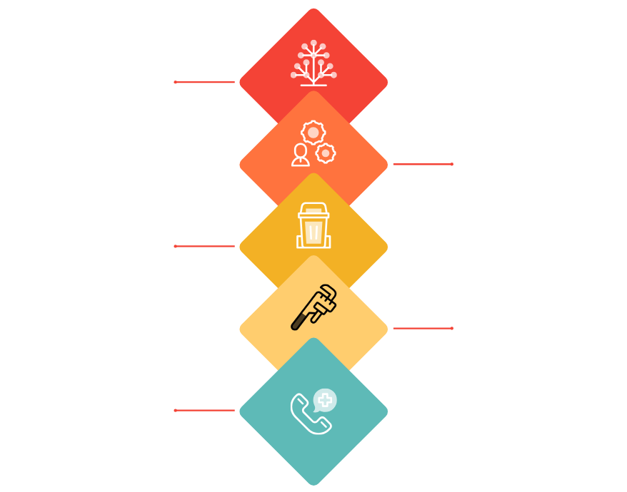
Where you want to go: branch-driven target design
Repo-first builds, managed pipelines, clear emergency lane
Branch map
Dev, release, main, hotfix branches determine what is built and released.
Environment roles
Dev, SIT, UAT, PreProd, Prod, Dev2 are execution and validation stages.
Repo-first artifacts
Artifacts (solutions) built from the branch repository, not from a lower environment.
Managed pipelines
Branch-driven builds feed deployed pipelines for predictable promotion paths.
Emergency lane
Clear hotfix branch and pipeline for rapid, controlled production fixes.

Slide 4
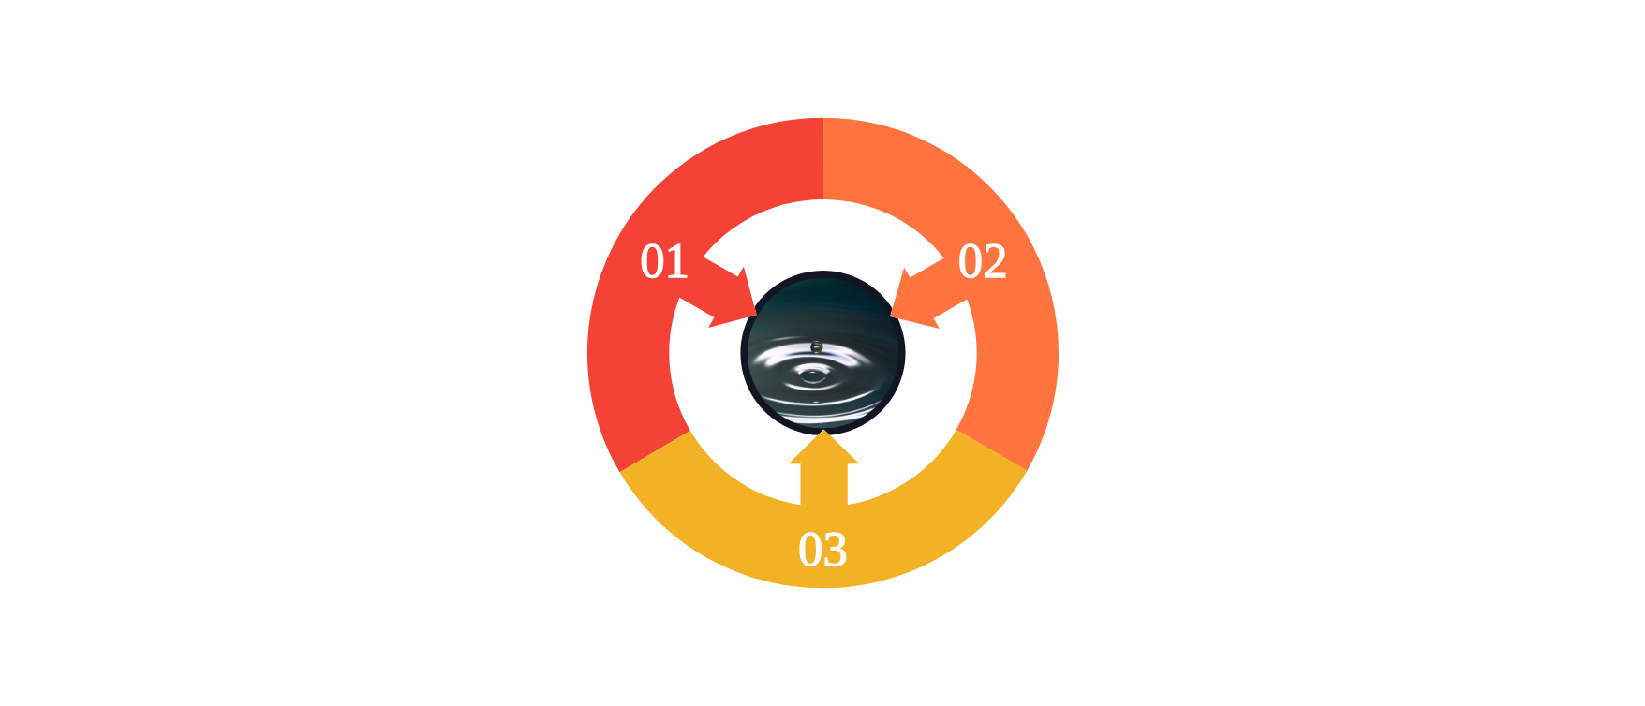
Repo as the single Source of Truth
Environments validate; branches define deployable artifacts
Bridge of Truth
Repository connects authoring to delivery; artifacts travel over CI and CD.
Sync Only from Environments
Environments run and validate; unpack to repo only to sync changes.
Artifacts Built from Git
Pack from branch to artifacts via CI; CD deploys artifacts from Git only.

Slide 5











Branch to Environment Mapping for CI/CD
Clear artifact ownership and managed vs unmanaged environments
Branch
Env(s)
Type
dev
Dev (unmanaged), SIT (managed)
Dev: unmanaged; SIT: managed
release
UAT (managed)
UAT: managed
main
PreProd (managed), Prod (managed)
PreProd: managed; Prod: managed
hotfix
Dev2 (unmanaged), Prod (managed)
Dev2: unmanaged (aligned with Prod for emergency fixes); Prod: managed

Slide 6




Pipelines overview: three pipeline families
Separation of Unpack, CI build, and CD for repeatable promotion gates
Unpack (Environment to Repo)
Export changes from Dev/Dev2, unpack into source format, commit to developer branches; must not produce deployable artifacts
01
CI Build (Branch to Artifacts)
02
Per-branch builds for dev, release, main, hotfix that produce reproducible artifacts from Git
CD (Artifacts to Environments)
Environment-specific pipelines that deploy branch-built artifacts and enforce promotion gates across SIT, UAT, PreProd, Prod
03

Slide 7
Pipeline A Unpack: controlled environment to branch flow
Manual unpack of maker changes using PAC CLI, PR review, no deployable artifacts
Developer works in Dev environment
Commit, push and open PR
Make changes directly in the Dev environment; makers are the source of edits
Commit and push feature branch, open PR from feature/foo to dev for review
Manual trigger: Run Unpack pipeline
PR review to keep history clean
Unpack is a controlled, manual step to capture maker changes only
Use PR review to trim build-time transformations and preserve clean maker history
Export unmanaged solution from Dev
Artifact policy: no deployable artifacts
Export the unmanaged solution artifact from the Dev environment for unpacking
Unpack artifacts must not include deployable build-time transforms or packaged outputs
pac solution unpack into feature branch
Use PAC CLI to unpack into a local feature branch such as feature/foo

Slide 8






Pipeline B: CI build per branch
Canonical CI: generate deployable artifacts for dev, release, main, hotfix
01
Trigger on merge or commit to the branch
04
Export managed solution from Build or source environment
1
Start CI when changes land in dev, release, main, or hotfix branches
dev branch
Generate managed solution zip for release and production
Unmanaged zip
1
02
Pack solution from unpacked folder to create unmanaged zip
release branch
05
Publish unmanaged and managed zips as pipeline artifacts
Unmanaged zip and managed candidate
Produce an unmanaged solution zip from the unpacked sources
1
Make artifacts available for downstream CD promotion
main branch
Managed production zip
03
Optional: import unmanaged into Build environment
1
06
Result: dev, release candidate, production, and hotfix builds
hotfix branch
Managed hotfix zip
Validate build by importing into a dedicated Build environment
Each branch yields a specific deployable artifact set

Slide 9
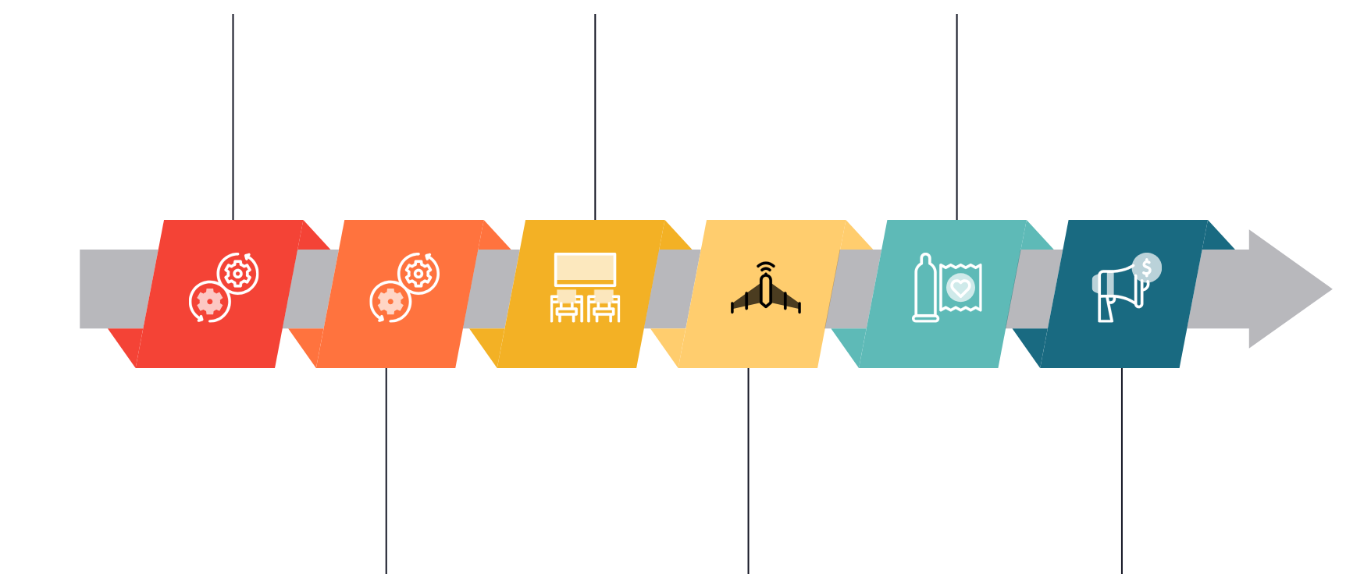
Pipeline C: CD pipelines by environment
Branch-specific artifacts with approvals and immutable promotion
Dev branch produces artifact
Promote to SIT
Promote to PreProd
Dev and SIT artifacts originate from dev branch; Dev uses unmanaged artifact, SIT uses managed artifact.
Deploy managed artifact to SIT from dev branch; include approval before promotion.
PreProd uses artifact from main branch; deploy the same managed zip planned for production.
Deploy to Dev environment
Promote to UAT
Promote to Prod
UAT uses artifacts built from release branch; require approval before deployment.
Production uses main branch artifact; deploy identical managed zip as PreProd after final approval.
Deploy unmanaged artifact to Dev for active development and testing.

Slide 10








Hotfix Loop: Dev2 Alignment and Emergency Flow
Emergency hotfix path preserving Dev2 and Prod parity
Branch from main and create hotfix branch
Start emergency work from main to isolate the fix
Optionally sync Dev2 from main to match Prod state
Ensure Dev2 mirrors Prod for reproducible fixes
Develop fix in Dev2 (unmanaged environment)
Implement and validate change in Dev2 before unpack
Goal: maintain Dev2 and Prod functional alignment
Unpack Dev2 into hotfix branch and push
Prevents drift and ensures hotfix reproducibility
Export unpacked solution into the hotfix branch for CI
CI builds hotfix artifact
Outcome: hotfixes flow back into normal release cadence
Automated build produces the hotfix artifact for deployment
Hotfix becomes part of standard main and release branches
Deploy to Prod via special hotfix CD pipeline
Use dedicated hotfix CD path to apply emergency changes
Merge hotfix into main, then release, then dev
Flow fixes back into main, release branch, and development
Emergency lane annotated: direct hotfix to Prod then merge back
Explicit emergency path preserves Prod stability and alignment

Slide 11










Concrete changes to your pipeline
Move from environment-driven artifacts to branch-driven builds
Stop using Dev environment as artifact source
Pack becomes repo to artifact build
Replace and unpack become environment to repo sync
01
02
03
Treat Dev environment as runtime only
Trigger pack from repository content
Replace+unpack write changes back to repository
Do not export CD artifacts from Dev environment
Build artifacts in isolated Build environment
Publish only validated managed artifacts
Sync should be Env to Repo only
Use Git as the single source of truth for artifacts
Avoid packing from Dev environment
Commit unpacked solution to feature branch
Prevent production artifact contamination
Merge flows remain Git driven
Recommendation: validate in isolated Build environment before publishing
Split CD logic by branch to target environment
05
04
dev branch deploys to Dev and SIT
Run CI outputs validation in Build environment
release branch deploys to UAT
Only publish managed artifacts after passing validation
main branch deploys to PreProd and Prod
hotfix branch deploys to Dev2 and Prod
Prevents contaminating production artifacts

Slide 12













GitHub-driven CI CD: branch workflows and artifact promotion
Map branches to build and deploy workflows; use Actions artifacts and gated promotions
Chaining and gates
Use workflow_run to chain builds to deploys and workflow_dispatch plus manual approvals for promotion gates.
Artifact management
Store managed and unmanaged zips as Actions artifacts for promotion and auditability.
Environment-specific deploys
deploy-dev-sit.yml, deploy-uat.yml, deploy-preprod-prod.yml for SIT, UAT, PreProd, Prod promotions.
Hotfix branch
build-hotfix.yml and deploy-hotfix.yml for urgent fixes and direct promotions. Use workflow_dispatch and push triggers.
Main / Release branches
build-main.yml and build-release.yml for mainline integration and releases. Use push and manual dispatch triggers.
Feature / Dev branch
build-dev.yml plus optional unpack-from-dev.yml; temporary solution created in Dev. Use push triggers.

Slide 13







Next Steps: Pseudo-YAML Offer and Governance
Concrete workflow files, diagrams, and branch controls to safely adopt ALM
Draft concrete GitHub Actions files: build-dev.yml, deploy-dev-sit.yml
Reference: pseudo-YAML example (build-dev.yml snippet) preserved
01
05
Produce ready-to-use workflow YAML for Dev and SIT deployments
Keep the offered pseudo-YAML as the base example
Draft concrete GitHub Actions files: build-main.yml and deploy-preprod-prod.yml
Recommend defining branch protection rules
02
06
Protect main and release branches before rolling to Production
CI for main branch and CD for PreProd and Prod promotion
Recommend enforcing PR policies aligned with ALM
07
Draft concrete GitHub Actions file: build-hotfix.yml
Require approvals, passing CI, and required reviews for merges
03
Separate hotfix workflow to minimize Prod risk
Provide Mermaid diagrams for docs
04
Visualize flow from Dev export to PreProd and Prod promotion

Slide 14








01
Make repository the single source of truth
02
Build artifacts from branches, not environments
03
Use Dev2 plus hotfix branch for emergencies
04
Create CI pipelines for dev, release, main, hotfix
Treat branches as canonical state; stop relying on dev environment
Produce deployable artifacts directly from branch CI
Isolate urgent fixes on hotfix branch merged back to main
Automate builds and tests per branch
Move to Branch-Driven ALM
Make the repo the source of truth and build artifacts from branches
05
Create CD pipelines per environment with approval gates
06
Define unpack pipelines as sync-only
07
Implement branch protection and pull request policies
08
Request: I can draft GitHub Actions YAML and diagrams
Unpack artifacts to source without altering branch history
Ask me to create workflows and architecture diagrams
Promote artifacts from branch to SIT, UAT, PreProd, Prod
Enforce reviews, status checks, and required approvals

